Slide 1
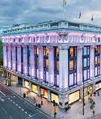
STORE DATA ANALYSIS
Analysing Sales, Customer Behaviour, and Trends
Name : Eniola Taiwo Date: 5th November 2024

Slide 2
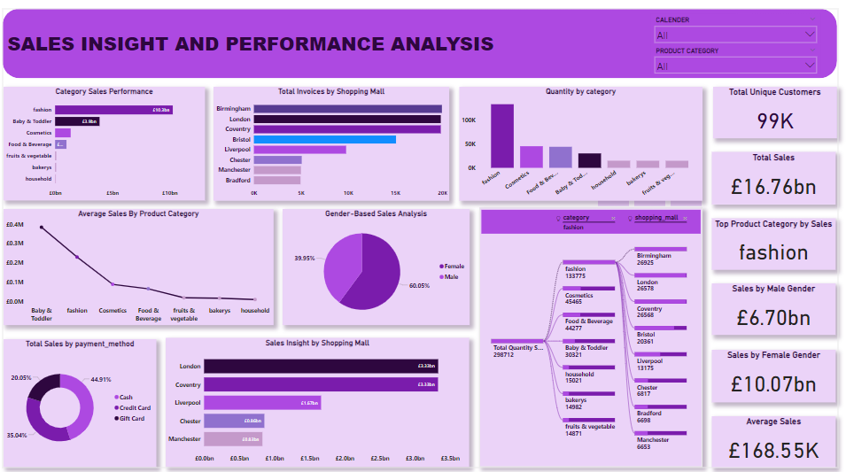

Slide 3
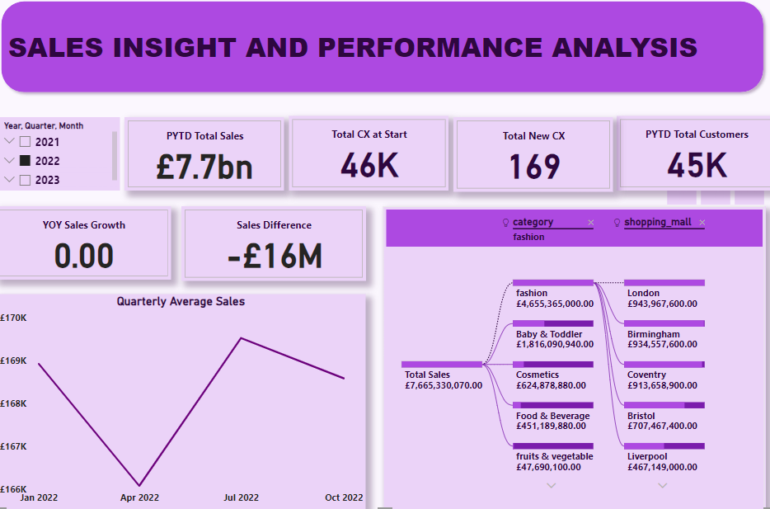

Slide 4
INTRODUCTION:
OBJECTIVES: This analysis is carried out to gain insights into the sales trends , customer preferences and predict future sales patterns to make data-driven decisions.
Overview of Analysis Types:
Descriptive Analysis: This analysis examines past transactions, trends, and sales patterns of the store, providing insights to understand causal factors ("why it happened"), forecast future outcomes ("what is likely to happen"), and inform actionable strategies ("what to do next"). Diagnostic Analysis: This analysis explains the underlying causes of observed patterns and trends, such as fluctuations in past sales for the store, variations in product popularity, and reasons behind high or low sales performance for specific items. Prescriptive Analysis: We will explore key strategies and actions the store should implement to ensure sustained success in the coming years.

Slide 5
Dataset Overview
Invoice No: Unique ID for each sale or transaction.
Customer ID for each customer, used to track buying patterns.
Gender: Indicates if the customer is male or female.
Category: Product category (e.g., Food, Fashion).
Quantity: Number of items sold per transaction.
Price: Price per item.
Sales Amount: Total revenue per transaction.
Payment Method: Payment option used (e.g., cash, card).
Invoice Date: Date of sale, important for trend analysis.
Shopping Mall: Store location, helps compare performance.

Slide 6
Data Relevance
Sales Amount: Shows overall revenue and sales performance.
Category & Quantity: Identify popular products and buying volume.
Gender & Payment Method: Understand preferences across customer groups.
Invoice Date: Analyse sales trends over time (daily, monthly).
Shopping Mall: Compare performance across store locations to inform investment.

Slide 7
Descriptive Analysis
Category Sales Performance: This shows the categories that are generating the highest revenue for the company
Gender-Based Sales Analysis: This analyse the distribution of sales amidst the two gender we have
Payment Method Analysis: This helps us to understand customer payment reference
Quarterly Average Sales Trend: This displays the
Quantity Sold by Product Category: This identify the most sold product by quantity
Category Sales Performance: Fashion achieved the highest revenue, reaching 103,000,000, followed by Baby and Toddler with 31,000,000. This marks a significant 69% difference compared to other categories with lower revenue figures.
Gender-Based Sales Analysis: Female customers contribute the majority of the sales volume, accounting for 60% of total company sales, while male customers make up the remaining 40%.
Payment Method Analysis: Cash is the most frequently used payment method, representing 47% of transactions, followed by credit cards at 32% and gift cards at 21%.
Quarterly Average Sales Trend: This analysis reveals an irregular sales trend each quarter. In the first quarter of 2021, average sales were 169,343, which rose to 171,163 in the second quarter before dropping in the third quarter, with fluctuations continuing thereafter.
Quantity Sold by Product Category: Over the course of three years, Fashion leads with the highest quantity sold, totaling 40,000 units, followed by Cosmetics with 14,101 units. All other categories have lower sales volumes in comparison.

Slide 8
Diagnostic Analysis 1
Sales Insight by Shopping Mall: Compares performance across different locations.
Average Sales per Transaction by Category: Analyses revenue efficiency per sale across categories.
Sales Insight by Shopping Mall:
Average Sales Per Transaction by Category:
Other Key Malls: Liverpool follows with £1.67B, Chester at £0.86B, and Manchester at £0.83B, suggesting varied demand across regions
London and Coventry top sales at £3.33B, indicating high consumer activity, likely due to larger population or retail presence.
Potential Factors: Population density, store sizes, or targeted promotions may contribute to these differences.
Top Categories: Baby & Toddler products lead at £384,824 per transaction, followed by Fashion at £230,827.
Other Notables: Cosmetics (£90,094), Food & Beverage (£67,145), and Household (£11,582) vary widely, reflecting distinct customer spending patterns.
Potential Factors: Price points, seasonal demand, and product-specific promotions may drive average transaction values.

Slide 9
Diagnostic Analysis 2
Customer Shopping Frequency by Gender: Explores if shopping behaviour varies by gender.
Invoice Count by Shopping Mall: Shows how many transactions occur at each location.
Customer Shopping Frequency by Gender
Invoice Count by Shopping Mall:
Loyalty Trends: Females show stronger loyalty and higher purchase frequency at 60.05% compared to 39.95% for males.
Potential Influencing Factors: Product mix, targeted campaigns, and shopping habits may contribute to gender-based frequency differences.
Regional Variation: Malls like Bristol (15,075) and Liverpool (9,781) show moderate activity, while smaller counts appear in Chester and Bradford.
Potential Influencing Factors: Proximity to high-traffic areas, event-based promotions, and mall accessibility may impact these counts.
Highest Invoice Count: Birmingham has the most invoices at 19,943, with close counts in London (19,823) and Coventry (19,822).

Slide 10
Predictive Analysis
Category Sales Growth Potential:
Gender-Based Sales Expansion:
Payment Method Optimization:
High Revenue Categories: Fashion and Baby & Toddler categories are expected to continue driving sales due to current high revenue levels. Targeted marketing and seasonal promotions can further amplify sales.
Prediction: If current trends hold, these categories may experience a 10-15% increase in sales over the next quarter due to high customer demand.
Recommendation: Increase inventory and introduce new product lines in these high-performing categories. Regularly monitor sales trends to adjust strategies accordingly.
Gender-Based Sales Expansion
Prediction: With focused campaigns toward male customers and a core main product line for the male gender we may see a 5-10% increase in male customer sales share.
Recommendation: Consider adding a new product line strictly for male and launching targeted marketing campaigns for male shoppers and expanding product offerings that appeal to this demographic.
Shift to Digital Payments: Cash is currently the dominant payment method at 47%, but a shift towards digital payments (credit/gift cards) is likely as more customers adopt online shopping habits.
Prediction: A 20% increase in digital payment usage over the next year is expected, especially with loyalty incentives for digital payments.
Recommendation: Incentivize credit and gift card usage by offering discounts or loyalty points. This could streamline checkout and improve transaction speeds.
Female Customer Segment: With females accounting for 60% of sales, they represent a strong segment. However, males could be an untapped potential.

Slide 11
Predictive Analysis 2
Sales Trends by Quarter
Product Category Forecast:
Shopping Mall Performance by Location
Seasonal Sales Fluctuations: Irregular trends suggest seasonal spikes. Q1 and Q2 typically see an increase in average sales, indicating seasonality.
Prediction: Implementing seasonal sales strategies, particularly in Q1 and Q2, in quarterly sales.
Recommendation: Plan seasonal promotions or clearance events during peak sales quarters to maximize revenue and smooth out fluctuations.
Product Category Demand Forecast can capitalize on this pattern, potentially leading to a 15% uplift
Prediction: Projecting an increase in demand for Fashion and Cosmetics in upcoming high-traffic periods (e.g., holiday seasons), with potential sales growth of 10-20%.
Recommendation: Enhance stock levels in these categories before high-demand periods, and consider bundling fashion and cosmetics for cross-selling opportunities.
Fashion & Cosmetics Demand: With Fashion leading in quantity sold, and Cosmetics showing a moderate demand, these categories can expect continued growth, especially during holidays.
Prediction: If population and foot traffic continue to trend positively, sales at these malls may rise by 8-12% over the next year.
Recommendation: Strengthen marketing efforts in high-performing regions and explore opportunities to expand customer reach in underperforming locations through localized promotions or events.
Regional Demand: Malls in London, Coventry, and Birmingham show high sales and transaction counts, likely due to higher foot traffic.

Slide 12
Driving Growth in Lower-Performing Categories
Targeted Customer Segmentation
Identify key customer groups likely to engage with lower-performing categories, such as Household and Bakery, and design specific marketing initiatives to reach them.
Promotion and Cross-Selling
Launch targeted promotions for these categories, leveraging cross-selling opportunities with high-performing categories (e.g., Fashion and Baby & Toddler). Encourage additional purchases by bundling items or offering discounts.
Product and Price Optimization
Use predictive insights to optimize product assortment, stocking popular items within low-performing categories. Adjust pricing to appeal to budget-conscious customers, maximizing purchase incentives.
Location and Demographic-Specific Campaigns
Tailor marketing campaigns by region, focusing on areas where certain categories have untapped potential. Engage specific demographics based on product preference trends.
Continuous Monitoring and Adjustment
Regularly monitor sales performance by category and location. Adjust strategies based on real-time data to maintain momentum and achieve sustained growth across all product categories.

Slide 13
BCG Matrix-Based Conclusion: Strategic Focus for Category Growth
Stars (High Growth, High Market Share):
Fashion and Baby & Toddler categories lead in both revenue and quantity sold, indicating strong demand. These should be prioritized with continued investment to maintain their growth momentum and capitalize on their popularity.
Cash Cows (Low Growth, High Market Share):
Cosmetics and Food & Beverage categories, though having moderate growth, consistently generate significant revenue. They provide steady cash flow and should be supported with targeted promotions to sustain their performance without extensive investment.
Question Marks (High Growth Potential, Low Market Share):
Bakery and Fruit & Vegetables show moderate performance but have the potential to grow. Consider experimenting with strategic marketing and product bundling to increase customer interest and boost their market share.
Dogs (Low Growth, Low Market Share):
Household products currently show low sales and limited growth potential. Resources here should be minimized or redirected unless there is a clear opportunity to reposition this category or align it with trending customer demands.

Slide 14
THANK YOU

